Slide 1
Introducing SharePoint Designer 2010
Notes:
SharePoint Designer 2010 is the recommended application to make customizations and build powerful solutions on top of SharePoint 2010. You will learn how and where SharePoint Designer fits into the big picture in accordance with related SharePoint technologies. You will also understand how to navigate around the SharePoint Designer environment and discover what each piece does.

Slide 2
Agenda
What’s new with SharePoint Designer 2010
SharePoint Designer 2010’s User Interface
Master Pages Included Out of The Box
Managing Site Permissions
Creating Custom Actions
Restricting SharePoint Designer

Slide 3


Ways to Customize SharePoint Sites
End Users
Designers
Site Admins
IT Professionals
Internet Explorer
Designers
Site Admins
Developers
IT Professionals
Developers
Notes:
Three customization options and build on top of SharePoint:
Browser: Any supported browser can be used to build components of SharePoint (sites, lists, libraries, workflows etc). No other system requirements exist when using the browser directly.
SharePoint Designer 2010: SharePoint Designer is a powerful tool to design and customize SharePoint Designer. This tool exists because the browser has limitations and is not able to take full advantage of all the components within SharePoint. SharePoint Designer requires a MS Windows based OS to install.
Visual Studio 2010: Visual Studio is the premier application for developers to build solutions on top of SharePoint. This software also requires a MS Windows based OS and also knowledge of programming.

Slide 4
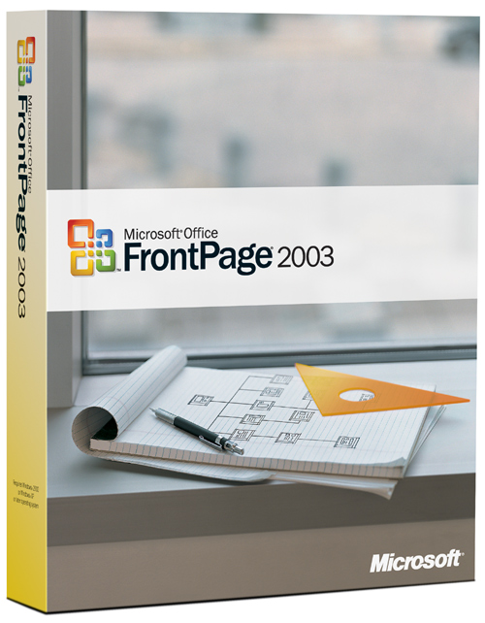
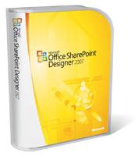
What is SharePoint Designer?
SharePoint features added to FrontPage
Built for SharePoint
Good for Building Automated Processes directly in Production
Built for SharePoint
Building Automated Processes in Dev to package for Production
Note:
SharePoint Designer 2010 is not compatible with SharePoint 2007
Notes:
History of SPD from FrontPage to SPD 2007 to SPD 2010.
Premier tool to customize SharePoint sites to realize your SharePoint investment. Best of all, it’s Free!
SharePoint Designer is the Premier Tool to Customize Components of SharePoint Sites.
SharePoint Designer (SPD) is targeted towards anyone building solutions on top of SharePoint sites. Members and readers of sites should continue using the browser to manage and view site content. However, Designers and Site Admins can use SPD to build robust solutions.
The browsers (IE, FireFox etc.) have limitations and cannot truly take advantage of all that SharePoint technologies has to offer. Your choices, to build solutions on top of SharePoint, are either to use SharePoint Designer or Visual Studio. Programming knowledge is required to work with Visual Studio. However, SharePoint Designer makes it easy for users of all ranks to work on and build solutions on top of their SharePoint sites.

Slide 5
SPD: Primary Tool to Customize SharePoint
Sites
Lists and Libraries
Pages
Workflows
Site Columns and Content Types
External Content Types
Master Pages and Style Sheets
Page Layouts
External Data (Databases, Web Services, XML Files)
Notes:
SharePoint Designer 2010 should be used by Site Admins and Designers to work with components of SharePoint sites. It doesn’t require the use of any programming language to be able to work in this environment (however, you can get your hands dirty in the code behind if you wish).

Slide 6
Agenda
What’s new with SharePoint Designer 2010
SharePoint Designer 2010’s User Interface
Master Pages Included Out of The Box
Managing Site Permissions
Creating Custom Actions
Restricting SharePoint Designer

Slide 7
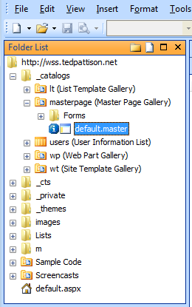
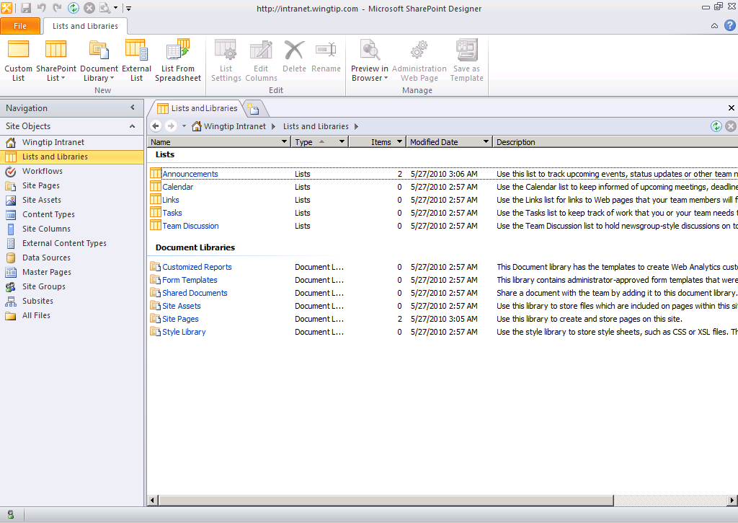
SharePoint Designer (SPD) 2010
SPD shell’s focus on SharePoint functionality & features
SPD 2010 is not compatible w/ SharePoint 2007
New UI focused on SP Objects
SPD 2007
SPD 2010
Notes:
SharePoint Designer has gone through many significant improvements:
SharePoint objects such as lists and workflow associations are seen as first class objects in the new UI.
Each SharePoint object has a summary page.
The new workflow designer is much more powerful.
SPD can create reusable workflows – this was a big problem in SPD 2007.
SPD 2010 is not backwards compatible and cannot be used to customize SharePoint 2007 sites.

Slide 8
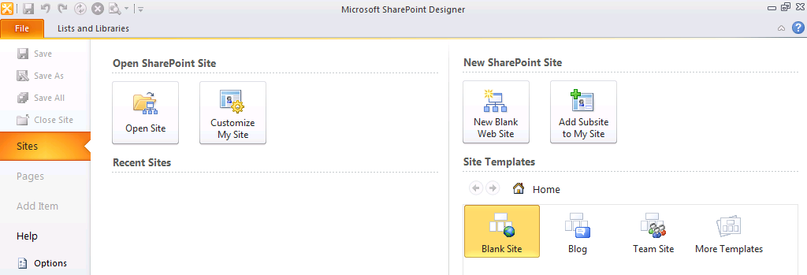
SharePoint Designer Backstage
Backstage is now prevalent all throughout the Office 2010 applications
Use SharePoint Designer Backstage to take actions at the site level
Create and open sites
Create pages and other items
Notes:
When first starting SharePoint Designer, Backstage is used to open or create sites within a site collection. Once a site is opened, you can use Backstage to create subsites, pages and other items. The Backstage is now prevalent all throughout the MS Office suite of products. So you’ll find the same type of interface in Word, Excel, PowerPoint etc.

Slide 9
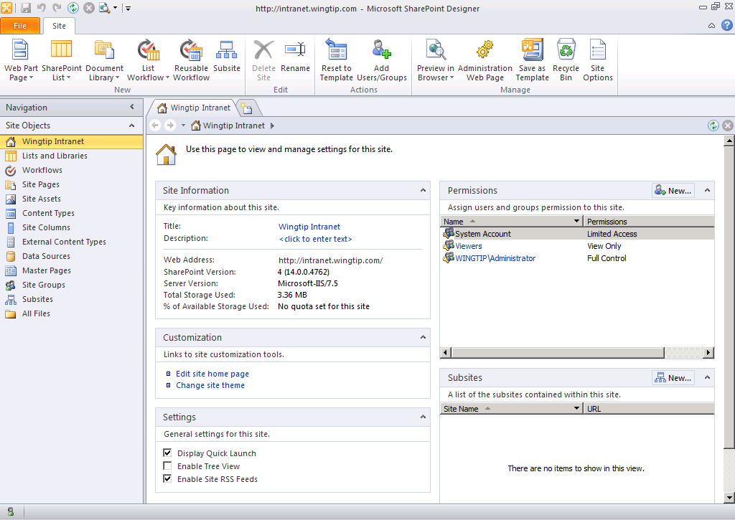
User Experience
Ribbon
Navigation Pane
Summary Page
Notes:
SharePoint Designer makes it easy and intuitive for the user to work with the components of a SharePoint site.
Next few slides focus on the three major navigational components:
Navigation Pane
Summary Page
Ribbon

Slide 10
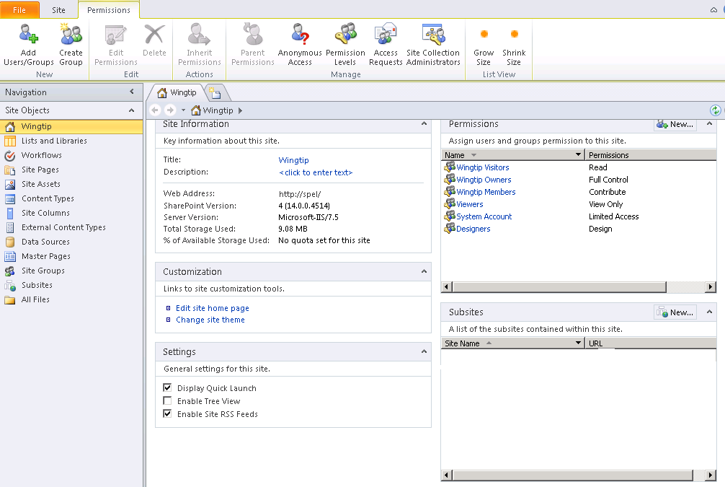
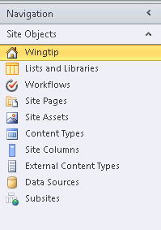
Navigation Pane
Navigation pane is a quick launch mechanism to all components of a SharePoint site
Options security trimmed based on permissions
Site Administrator
Site Designer
Notes:
Navigation Pane serves as a “Quick Launch” within SharePoint Designer. Site components such as lists, libraries, workflows, content types etc. can all be accessed directly through links in the navigation pane.

Slide 11
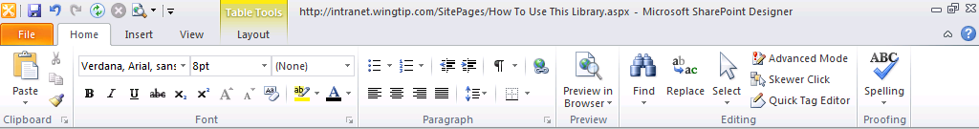
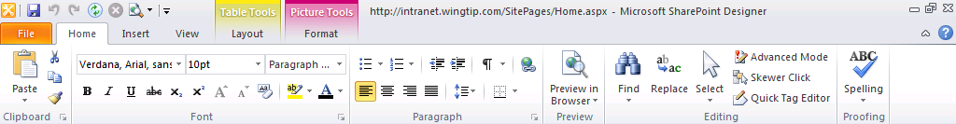
Ribbon
Ribbon provides the fluent user interface
Context sensitive
Notes:
The ribbon now provides the fluent user interface in all Office applications including the SharePoint interface. It has made its way into SPD as well.
Ribbon facilitates easy navigation to actions specific to the current context. It is also security trimmed so if a user doesn’t have permissions to perform a certain action, that option will be disabled in the ribbon.

Slide 12
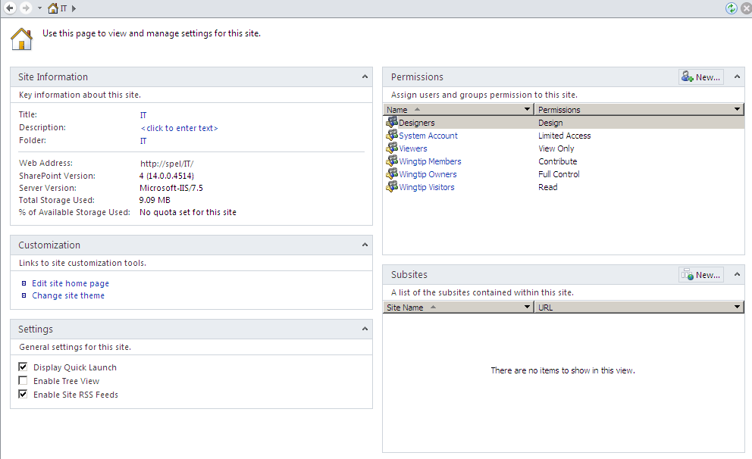
Summary Page
Summary page is available for all SharePoint objects (Lists, Libraries, Workflows etc)
Provides easy access to object’s settings and customizations
Notes:
A list summary page is shown above. It shows, among other things, the views implemented on the list, the forms available to interface to the user and the workflows attached to this list.
Summary pages are available for all configurableSharePoint objects.

Slide 13
DEMO
SharePoint Designer 2010 Walkthrough

Slide 14
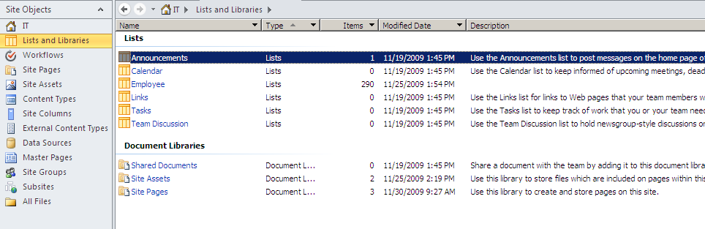
Lists and Libraries
All lists and libraries and its metadata appears in this view
Notes:
All lists and libraries available on the site. Using Ribbon, you can create additional lists or edit the properties of the lists.

Slide 15
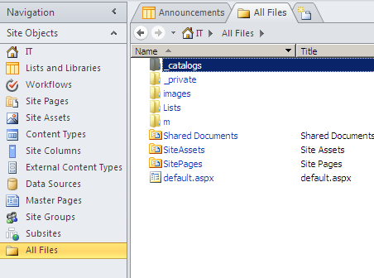
All Files View
All Files view shows all of the components of the site
Serves as an ‘Explorer’ type view for the site
Most of these objects are available also through the navigation pane
Notes:
Hidden folders (_catalogs, _private, _cts) are only viewable through this view.
The All Files view is the Explorer type view that lets you access all of the SharePoint site’s objects.

Slide 16
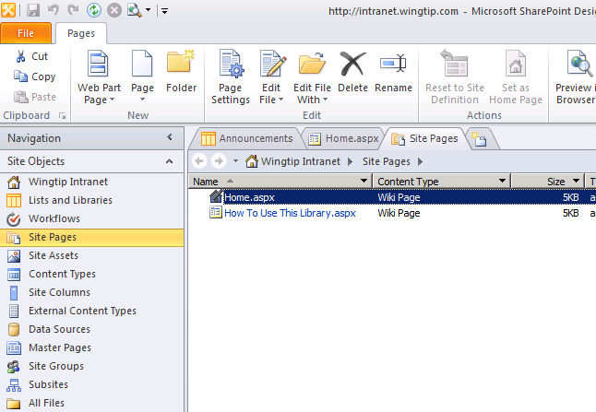
Site Pages
Two site pages created by default
Home.aspx
How To Use This Wiki Library.aspx
Notes:
Site pages are wiki pages available directly from SPD to customize.

Slide 17
Agenda
What’s new with SharePoint Designer 2010
SharePoint Designer 2010’s User Interface
Master Pages Included Out of The Box
Managing Site Permissions
Creating Custom Actions
Restricting SharePoint Designer

Slide 18
Master Pages
v4.master
User content pages (lists\content pages\etc)
_layouts pages (site settings, etc)
minimal.master
If you do not need site navigation
If you do not have a ribbon
If your app needs the space
default.master
Show site using legacy interface
Team site Master Page
For app experiences, like Search or Office Web Applications
No Ribbon, no fluency
Notes:
SharePoint 2010 ships with a number of master pages.
Application pages can now also make use of branded master pages.
default.master: includes non-fluent v3 UI for backwards compatibility.
v4.master: default v4 UI (with the UI).
Minimal.master: no branding… good for starting a custom branded site.

Slide 19
DEMO
Explore Site Pages and Master Pages

Slide 20
Agenda
What’s new with SharePoint Designer 2010
SharePoint Designer 2010’s User Interface
Master Pages Included Out of The Box
Managing Site Permissions
Creating Custom Actions
Restricting SharePoint Designer

Slide 21
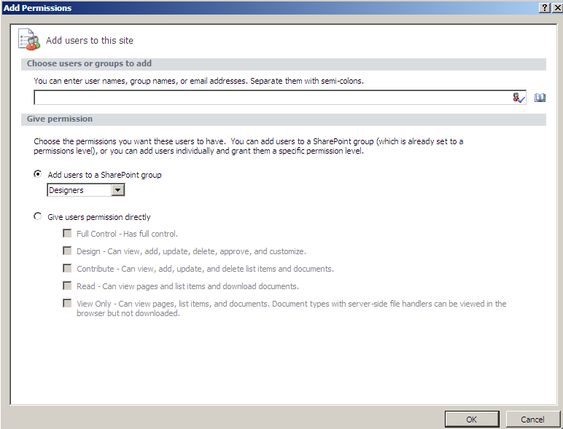
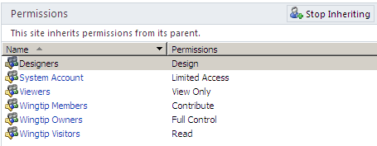
Managing Site Permissions
Manage users and groups directly from within SharePoint Designer
Notes:
Managing permissions becomes pretty easy to do within SPD 2010.
New SharePoint Groups can be created.
AD users and groups can be added directly to the SharePoint Groups.
Anonymous access can be enabled.
All this can be done without leaving the SharePoint Designer!

Slide 22
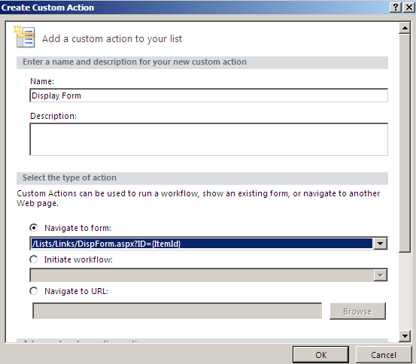
Light Up with User Custom Actions
Add commands to common locations
ECB (Edit Control Button – context menu)
Ribbon
Form Toolbars
View Toolbars
Settings pages
Notes:
The User Custom Action capability of SharePoint 2010 allows end-users to customize the user interface without the need to involve IT. This includes adding content to the ribbon.
One of the key aspects of what end-users cannot do, is making use of code in the form of user and custom controls. The reasons for not allowing this are obvious: security and stability.
Adding custom actions to Form Toolbars and View Toolbars. Toolbars will be disabled by default in the V4 UI and any custom actions will show up in the Custom Commands section of the ribbon. If the custom actions use a code behind they don't show up at all unless you enable to tool bars using the ListViewWebPart.

Slide 23
DEMO
Managing Site Permissions and
Creating Custom Actions

Slide 24
Agenda
What’s new with SharePoint Designer 2010
SharePoint Designer 2010’s User Interface
Master Pages Included Out of The Box
Managing Site Permissions
Creating Custom Actions
Restricting SharePoint Designer

Slide 25
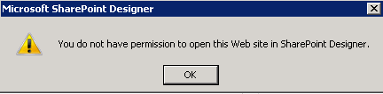
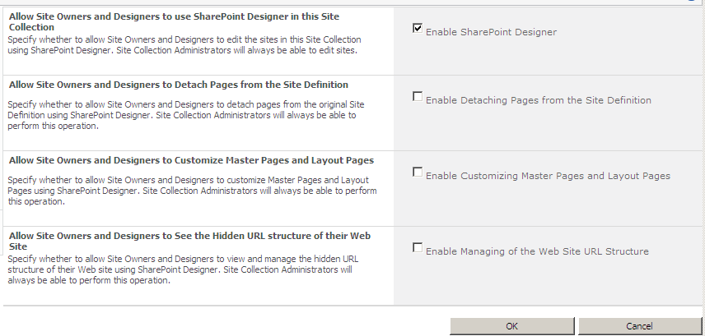
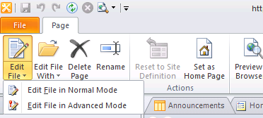
Restricting SharePoint Designer
Revoke permissions as needed from Site Owners and Designers
Notes:
SharePoint Designer is a powerful application. If not used properly, it can have adverse affects on the site.
Site collection administrators can decide to turn off certain features of SPD for Site Owners and Designers as shown in the image on the slide. All objects in SPD are context sensitive. Thus, if certain permissions are revoked, the appropriate objects will ‘turn off’ and become unavailable from the SPD interface (ex: Master Pages, All Files, Advanced editing mode etc).
Further, SharePoint farm administrators can limit SPD’s use within a Web application from Central Administration. These settings trump any site collection administrator’s selections (if blocks are used).

Slide 26
DEMO
Restricting SharePoint Designer Usage

Slide 27
Summary
What’s new with SharePoint Designer 2010
SharePoint Designer 2010’s User Interface
Master Pages Included Out of The Box
Managing Site Permissions
Creating Custom Actions
Restricting SharePoint Designer

